Slide 1

Constructive journalism
Concept & foundations
Solutions, nuance and perspectives, dialogue

Slide 2

What is constructive journalism?

Slide 3
If it bleeds, it leads.

Slide 4
A shift away from only covering conflict and problems to also addressing solutions to challenges and ways of moving forward.

Slide 5
It provides an accurate, contextualized picture of the world – all while staying true to the media's core functions and ethics.

Slide 6
Traditional mindset
MANY LOVED ONES WILL DIE
Headline in „Daily Mail“: March 13, 2020
Negative
Sparks fear
Sense of doom

Slide 7
Constructive mindset
TOGETHER WE CAN SAVE MANY LIVES
Headline in „Irish Daily Mail“: March 13, 2020
Reframed
More hopeful
Showing possibilities
Telling the whole story

Slide 8
Shift in mindset
Will Zoom spell doom for business air travel?
Deutsche Welle, https://www.dw.com/en/zoom-vs-handshake-battle-to-impact-business-air-travels-fate/a-56802955
What‘s the headline communicating?
The picture shows a woman sitting in front of her laptop and burying her face in her hands. What is the picture doing?
How could we reframe the story of business travel being hit by COVID?
Notes:
Sure, this is bad news for the airlines and business travel industry. And there is a place for this story, but let‘s make sure we look at the whole picture:
Do business people need to travel as much?
What are the effects on the climate?
Will new ways of meeting be good for productivity?
How is the industry that caters to this clientele adapting?

Slide 9
Constructive journalism – in a nutshell
Shift away from exclusive focus on conflict and the negative
Keeps a rigorous approach and critical stance
Not just: What happened and who did it?
But also: What do we do about it? How do we proceed?
Speaks truth to power AND inspires potential for solutions
Presents not just half the picture but the FULL STORY

Slide 10
Is it good journalism?
Constructive journalism adheres to core principles of rigorous, ethical journalism:
Fact-based
Unbiased
Critical
Objective
Balanced

Slide 11
“Constructive journalism does not seek to replace breaking news or investigative journalism,
it complements them.”
Constructive Institute, Denmark

Slide 12
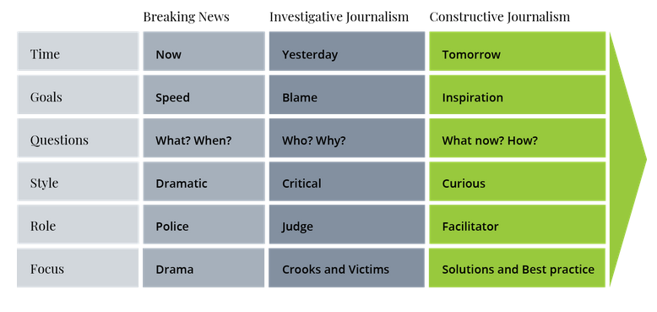
Constructive journalism – an additional layer
Source: Constructive Institute, Denmark
Notes:
There is a place for bad news – bad things happen. The problem is that journalists usually only talk about the bad news. Especially in this toxic 24//7 fast speed publication cycle.
Constructive journalism completes the picture and allows to move forward.
Explainer-Video of the Constructive Institute: https://www.youtube.com/watch?v=hrFuQ4SjUO4 (duration: 2.5 minutes)
Explainer-Video of DW Akademie: …

Slide 13
What are the ingredients for constructive journalism?

Slide 15
Solutions
  Going beyond covering the problems
Covering responses that seek to solve problems
Example:
https://today.lorientlejour.com/article/1329152/this-lebanese-inventor-built-his-own-wind-turbine-to-power-his-house.html
Notes:
Present examples of solution stories – from your region?
Kenya: https://news.trust.org/item/20210415025427-k44tr
India: https://www.news18.com/news/india/with-food-for-all-poor-and-door-to-door-coronavirus-screening-pandemic-hit-bhilwara-sets-example-for-rest-of-india-2551605.html
How coordinated efforts kept the population in one city under strict lockdown from going hungry, which led to successful self-isolation protocols
Officials say the major credit for the lockdown’s success goes to various donors, NGOs and social outfits, who have come together to ensure that nobody here goes hungry.

Slide 16
Nuance and perspectives
  Search for in depth understanding of complex issues
  Question your own (pre-)conceptions
  Look for different perspectives
  Zoom in and out
Example:
https://theconversation.com/why-some-muslim-women-feel-empowered-wearing-hijab-a-headscarf-155110
Notes:
Add nuance instead of painting in broad stereotypes or in black and white.
The Conversation article looks at different reasons why women wear the hijab. Doesn't just look at it as a symbol of oppression.
The first embrace: World Press Photo Contest 2021:
https://www.worldpressphoto.org/collection/photocontest/2021
If you compare to former winner pictures…
The photographer Mad Nissen shows a 85-year old brazilien woman embraced by a nurse, it was the first hug she received in five months – due to lockdwon and pandemic restrictions. Carers invented „a hug curtain“ to enable physical contact without infection risk.
Context is crucial!
BBC: https://www.bbc.com/news/explainers-56665396
How does the risk of serious side-effects from the Astra-Zeneca vaccine compare with other risks?

Slide 17
Constructive dialogue
Bring together people with opposing views
  Search for common ground
Ask for motivations and feelings
Show empathy but stay unpartial
Example:
https://www.mycountrytalks.org/events/deutschland-spricht
Notes:
https://www.zeit.de/gesellschaft/2019-11/germany-talks-discussion-issues-democracy-english
Some recent examples of reporting sourced from 2020 Deutschland spricht: In May of 2020 they published a stories about the digital meetings of people with very different positions on the coronavirus and issues such as mask mandates
People won't always agree, even after talking. But talking is usually better than NOT talking.
Another example: Putting people (parents in this case) in touch with professionals. Getting questions answered. Calming fears.
https://www.nytimes.com/2020/03/09/parenting/coronavirus-parents-need-to-know.html

Slide 18
What are the goals of constructive journalism?

Slide 19
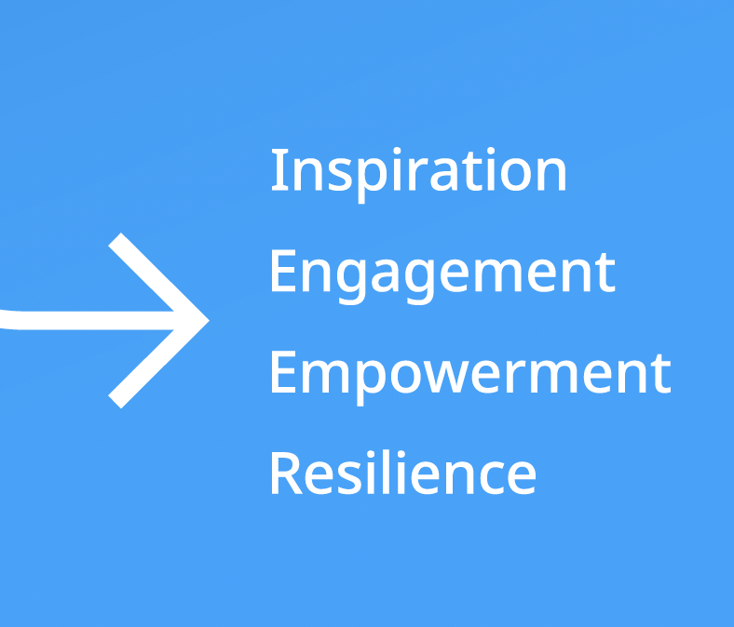
Constructive journalism – the goals
Informing without inflaming
Creating positive emotions (optimism, hope)
Counterbalalancing negativity
Increasing public engagement to tackle problems
Strengthening audience connections
Decreasing „learned helplessness“
Lowering the overall temperature and tension
Reducing polarization, overcoming divisions

Slide 20
Which story is constructive?

Slide 21
Topic – Child drowning deaths in Bangladesh
Dhaka Tribune, July 25th, 2021
Children under 10 account for 70% of drowning deaths in Bangladesh
http://bit.ly/43hu6nF
VOA, September 24, 2014
Watery Bangladesh works to prevent child drowning deaths
http://bit.ly/3ZKeh5H
Notes:
Two articles on the same topic,
The one from Dhaka Tribune reports on survey results – statistics in detail on the status quo. Only at the very end, you learn that „some work is being done in several districts on a pilot basis and that the Bangladesh government is planning to expand these activities for child protection across the country.
The one from VOA reports on one solution: swimming lessons for children. And that this helped in one area to reduce the number of drowning accidents. You also learn that most drowning deaths happen when unsupervised children fall into ponds near their homes. 75% within 20 meters of home. And that sometimes people say that it is god‘s will when a child dies in that way. This could even be explored further in a constructive way???
https://archive.dhakatribune.com/bangladesh/2021/07/25/children-under-10-account-for-70-of-drowning-deaths-in-bangladesh#:~:text=Children%20under%2010%20account%20for%2070%25%20of%20drowning%20deaths%20in%20Bangladesh,-Tribune%20Desk&text=As%20many%20as%201%2C512%20people,according%20to%20a%20recent%20survey.

Slide 22
Topic – Tourism industry hit by pandemic
Deutsche Welle, September 3, 2021
How can travel be more sustainable post-pandemic?
https://www.dw.com/en/coronavirus-how-can-travel-be-more-sustainable-post-pandemic/a-56784730
The Times of India, March 8, 2020
Covid-19 worst catastrophe faced by the tourism industry
https://timesofindia.indiatimes.com/city/pune/covid-19-worst-catastrophe-faced-by-the-tourism-industry-taai/articleshow/74532293.cms
Notes:
The Times of India reports on the negative effects on the tourism industry.
DW looks at the bigger picture and how in the future travel could become more sustainable.

Slide 23
Topic – Gender-based violence
Chicago Sun Times, August 4, 2021
In Pakistan, woman‘s brutal killing, beheading casts a harsh spotlight on gender-based violence
https://chicago.suntimes.com/2021/8/4/22609169/pakistan-brutal-killing-violence-against-women
Apolitical, September 24, 2014
Ending violence in Pakistan starts in the playground
Pakistan is rated 148 of 149 countries for gender equality – can play change that?
https://www.voanews.com/a/watery-bangladesh-works-to-prevent-child-drowning-deaths/2460992.html

Slide 24
A closer look at solution stories

Slide 25
Is it good journalism?
Video Solutions Journalism – an explainer
https://www.youtube.com/watch?v=D9Jwi2i_K-M

Slide 26
The must-have pillars of a solutions story
Solution / response
Evidence
Lessons
Limitations

Slide 27
Pillar 1 – Solution / response
Tell the story of how people are trying to solve a problem
People need
  to know that change is possible and
  to see models of how to do it
But don‘t forget to describe the problem and its relevance:
  Who is affected? In which way?

Slide 28
Pillar 2 – Evidence
Include data on effectiveness of the solution
Include testimonies that the solution works.
Be transparent if there‘s no data and no proof at all!

Slide 29
Pillar 3 – Lessons / insights
Describe how the solution works.
Describe the challenges, struggles and lessons learned.
Keep in mind that people in other places might struggle with similar problems. What do they need to know in order to replicate a solution?

Slide 30
Pillar 4 – Limitations
No solution is perfect!
Explain what are the limitations:
  For whom does the solution work?
  In which geographical area?
  When?
Reasons for limitations might be lack of money, manpower, commitment, misconceptions, lack of sustainability.

Slide 31
Deconstruct a solution story:
Solution / response?
Evidence?
Lessons / insights?
Limitations?
Notes:
Choose a solution story from your region and let trainees identify the four pillars and discuss their quality.

Slide 32
Things to avoid!
Hero worship
Silver bullet
Instant activist
The heart-warmer
Notes:
Hero worship: Stories that celebrate a person are fine, but a good solutions stories put the focus on the person's actions or solution being tried instead of their character.
Silver bullet: These stories exaggerate solutions, overclaim without much evidence.
Instant activist: These are direct and emotional requests to be part of a cause to solve a problem. Click here and contribute!
The heart-warmer: Stories about kind, humane acts by people are newsworthy but they are not solid solutions journalism. And sometimes they might just be publicity.

Slide 33
Any potential for constructive journalism?

Slide 34
1 Brainstorm on problems in your country/communities
2 Reflect on how to tackle them constructively?

Slide 35
Thank you

